Slide 1
Process of developing e-content
For
STEM
Dr. Ajita Deshmukh
MIT-ADT University

Slide 2
First Step
ADDIE
Needs & Constraints
01
ANALYZE
Outcome based Activities
02
DESIGN
Production
03
DEVELOP
Put to Action
04
IMPLEMENT
What worked/didn’t?
EVALUATE
05

Slide 3
Let’s go stepwise!
ADDIE
ANALYZE
01
Needs & Constraints
DESIGN
02
Outcome based Activities
DEVELOP
03
Production
IMPLEMENT
04
Put to Action
EVALUATE
05
What worked/didn’t?

Slide 4
Getting into the process
Objectives & outcomes
01
02
Conceptualize
STEM
Develop & Cultivate
04
03
Document the design

Slide 5
Mapping the STEM e-content
Desired Outcome
01
02
03
Data collection
Feasibility
Content Type
What type of response do you want for the content?
Device availability
Select an appropriate type

Slide 6
E-content in STEM
Experiential
Hands- on
Heart on
Theory + Practical
Text
Images/Infographics
Videos
Animation
Simulation
AR/VR
Interactives
Manipulatives
Comic Strips
Podcasts

Slide 7
What do students want?
01
Adaptive
Personalise
Mobile Learning
Learning of STEM
02
Gamified
Interactive
Immersive
03
Microlearning
Chunked content
Clear outcomes

Slide 8
Mapping STEM content- examples
 | Desired Outcome | Data collection | Type of e-content
Definition/ Law/ Short text | Student should read | Via LMS- school computer lab | H5p- interactive/ Doodle video/
 | Student should be able to phrase the definition | PC, internet | Drag and drop correct words mark the words
 | Should be able to recite | Mobile phone only | Audio msg

Slide 9
Mapping STEM content- examples
 | Desired Outcome | Data collection | Type of e-content
Diagram | information about parts | Via LMS- school computer lab | H5p- interactive/ crosswords
 | Label the diagram | PC, internet | Image hotspot, Drag and drop
 | Draw/ Apply |  | Draw /Jigsaw puzzle

Slide 10
Mapping STEM content- examples
 | Desired Outcome | Data collection | Type of e-content
Science Practical application | Practical skill |  | Demonstration + practical at home
 | Application | Physical or virtual | Project
 | Create |  | Toy making/ Stop motion video

Slide 11
Popular STEM content formats
01
02
03
04
Podcasts
Comic books
Gifs/Stickers
Games
Stories
Interviews
Experiences
Creative writing
Micro learning
Creative Expression
Challenge
Concept building

Slide 12
Science = curiosity + open-mindedness, + learning from failures.
Dr. Ajita Deshmukh

Slide 13
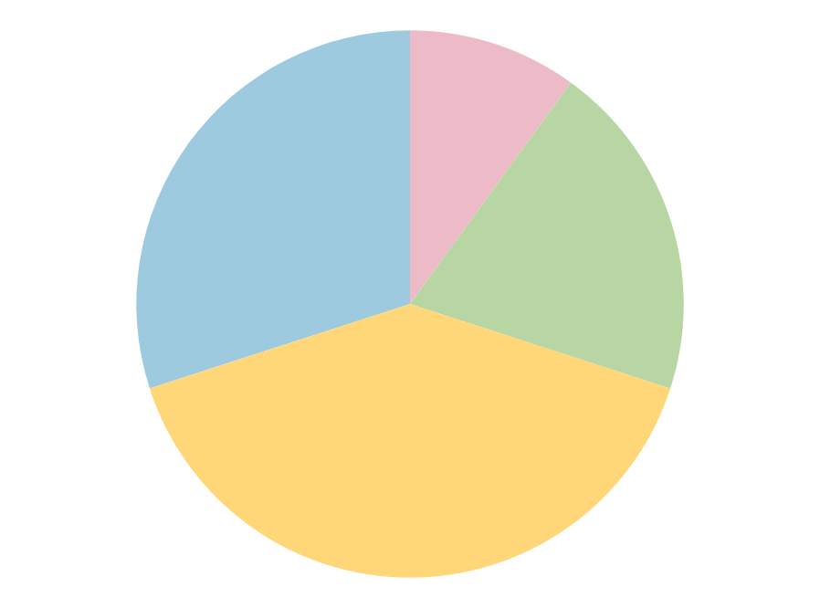
Popular STEM content formats
10%
Gap 2
Mitosis
Jupiter is a gas giant and the biggest planet
Neptune is the farthest planet from the Sun
40%
20%
Synthesis
Gap 1
Mercury is the closest planet to the Sun
Despite being red, Mars is a cold place
Follow the link in the graph to modify its data and then paste the new one here. For more info, click here

Slide 14
STEM infographics
Cells are considered the basic units of life
Internal
External
All cells are surrounded by a structure called
It serves as a boundary between the cell's internal and external environments
The cell membrane

Slide 15
STEM infographics
Jupiter is a huge gas giant named after the Roman god of the skies and the lightning
Eukaryote
Yes
Nucleus
No
Venus has a very beautiful name but is actually terribly hot, even more than Mercury
Prokaryote

Slide 16
STEM infographics
01
02
Mitosis
Meiosis
4 stages
Somatic cells
Cellular proliferation
2 diploid cells
New cells
Similar basic steps
Single parent cell
8 stages
Germ cells
Reproduction
4 haploid cells

Slide 17
STEM infographics
Prophase
Prometaphase
Jupiter is the biggest planet
Neptune is very far from the Sun
Cytokinesis
Metaphase
Mitosis
Mercury is quite a small planet
Despite being red, Mars is a cold place
Telophase
Anaphase
Venus is the second planet from the Sun
Pluto is considered a dwarf planet

Slide 18
STEM infographics
01
03
Ribosomes
Vacuoles
Jupiter is a gas giant and the biggest planet
Mercury is the closest planet to the Sun
02
04
Lysosomes
Peroxisomes
Neptune is the farthest planet from the Sun
Despite being red, Mars is actually a very cold place

Slide 19
STEM infographics
01
Mitochondria
02
Matrix
Granules
Jupiter is a gas giant and the biggest planet
Neptune is the farthest planet from the Sun
03
04
Membrane
DNA
Mercury is the closest planet to the Sun
Despite being red, Mars is a cold place

Slide 20
STEM infographics
45
Mitosis
Cell nucleus divides
Minutes
Pairs of chromatid
15
Cytokinesis
Cytoplasm divides
Minutes
Two new cells

Slide 21
STEM infographics
01
Interphase
Prophase
The cell’s nucleus divides during the mitosis phase
Metaphase
The cell cycle
02
Mitosis
Anaphase
Telophase
03
Cytokinesis

Slide 22
STEM content
Text
Videos
Chloroplast
Neptune is very far from the Sun
Venus is the second planet from the Sun
Cytoplasm
Cell wall
Despite being red, Mars is a cold place
Mercury is quite a small planet
Vacuole
Pluto is considered a dwarf planet

Slide 23
STEM infographics
 |  | Prophase | Metaphase | Anaphase
 | Somatic | Venus has a beautiful name | Mercury is the smallest planet | Earth is where we all live on
 | Stem | Saturn is a gas giant with rings | Jupiter is the biggest planet | Neptune is very far from the Sun
 | Embryonic | Ceres is located in the asteroid belt | Pluto is now a dwarf planet | Despite being red, Mars is cold

Slide 24
STEM infographics
Prophase
Prometaphase
Metaphase
Jupiter is the biggest planet
Neptune is very far from the Sun
Despite being red, Mars is a cold place
01
02
03
04
05
06
Anaphase
Telophase
Cytokinesis
Pluto is considered a dwarf planet
Venus is the second planet from the Sun
Mercury is quite a small planet

Slide 25
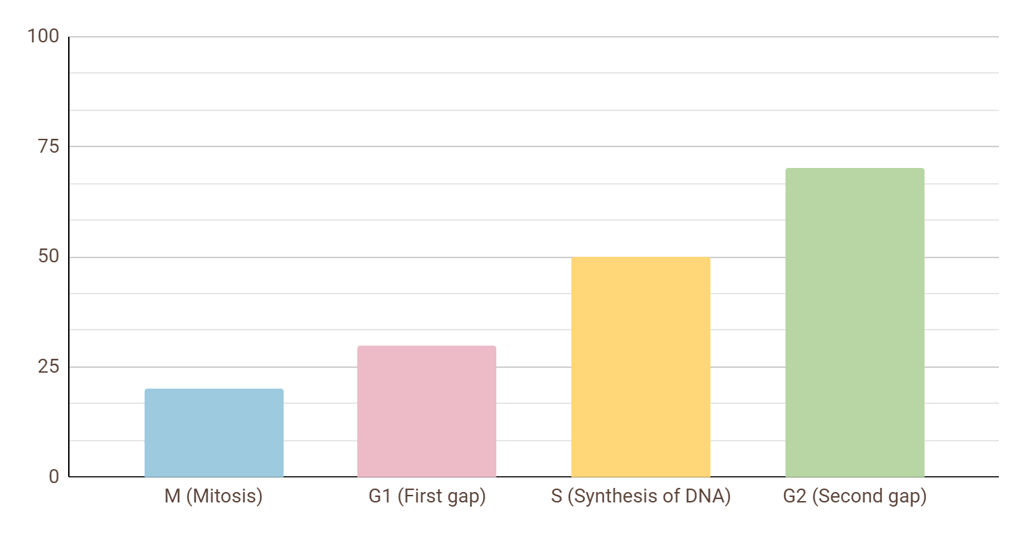
STEM infographics
Cell life cycle
20%
30%
50%
70%
Jupiter is a gas giant and the biggest planet
Follow the link in the graph to modify its data and then paste the new one here. For more info, click here

Slide 26
STEM infographics
01
02
03
04
Membrane
Matrix
Granules
DNA
Mercury is the closest planet to the Sun
Jupiter is a gas giant and the biggest planet
Neptune is the farthest planet from the Sun
Despite being red, Mars is actually a very cold place

Slide 27
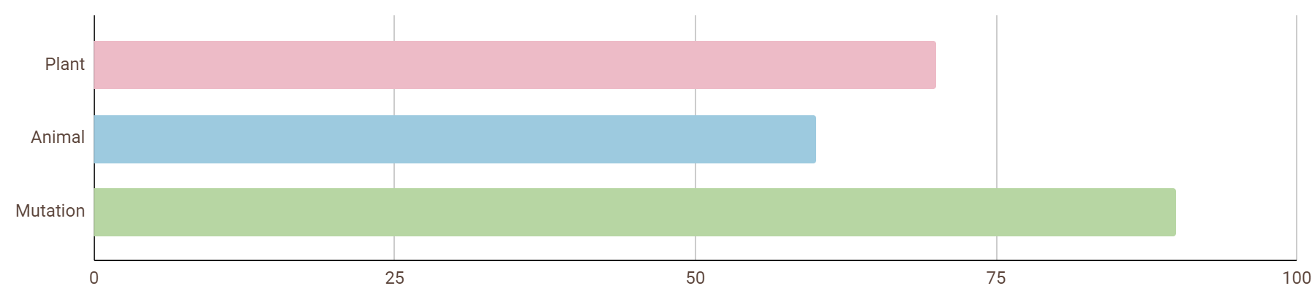
STEM infographics
70%
60%
90%
Plant cells
Animal cells
Mutation
Mercury is the closest planet to the Sun
Jupiter is the biggest planet in the Solar System
Neptune is the farthest planet from the Sun
Follow the link in the graph to modify its data and then paste the new one here. For more info, click here

Slide 28
STEM infographics
02
Animal cells
Jupiter is the biggest planet of them all
01
03
Plant cells
Mutation
Mercury is the closest planet to the Sun
Neptune is the farthest planet from the Sun

Slide 29
STEM infographics
8 stages
Germ cells
Jupiter is the biggest planet of them all
Saturn is composed of hydrogen and helium
Meiosis
Mercury is the closest planet to the Sun
Reproduction
4 haploid cells
Neptune is the farthest planet from the Sun
Despite being red, Mars is a very cold planet

Slide 30
STEM infographics
Nucleus
Jupiter is the biggest planet
80%
Mitochondria
Neptune is very far away from us
60%
30%
Cytoplasm
Despite being red, Mars is a cold place

Slide 31
Infographics
You can add and edit some infographics to your presentation to present your data in a visual way.
Choose your favourite infographic and insert it in your presentation using Ctrl C + Ctrl V or Cmd C + Cmd V in Mac.
Select one of the parts and ungroup it by right-clicking and choosing “Ungroup”.
Change the color by clicking on the paint bucket.
Then resize the element by clicking and dragging one of the square-shaped points of its bounding box (the cursor should look like a double-headed arrow). Remember to hold Shift while dragging to keep the proportions.
Group the elements again by selecting them, right-clicking and choosing “Group”.
Repeat the steps above with the other parts and when you’re done editing, copy the end result and paste it into your presentation.
Remember to choose the “Keep source formatting” option so that it keeps the design. For more info, please visit our blog.

